Slide 1
Marketing and Retail Analysis : Market Basket Analysis
MILESTONE-02
BIBEK KUMAR GIRI
PGP-DSBA-JULY-21

Slide 2
CONTENTS
Agenda and Executive summary of the Data
Exploratory Data analysis and Inferences
Use of Market Basket Analysis(Association Rules)
Associations Identified
Recommendations

Slide 3
Problem Statement:
A Grocery Store shared the transactional data with us. Our job is to identify the most popular combos that can be suggested to the Grocery Store chain after a thorough analysis of the most commonly occurring sets of menu items in the customer orders. The Store doesn’t have any combo meals.
Agenda:
The Agenda of this project is to find the combos patterns of the customers from last 03 years of data from a Grocery Store. And suggest them some inferences regarding combos and few lucrative ideas to increase there sales.

Slide 4
Software used
For Preprocessing of Data: Python or Jupyter NB
For EDA : Tableau → Link : https://public.tableau.com/views/mra2_2/No_ofproducts?:language=en-US&:display_count=n&:origin=viz_share_link
For Market Basket Analysis: KNIME Analytics Platform

Slide 5
Sample Dataset:
Top 05 Rows of Dataset
 | Date | Order_id | Product
0 | 01-01-2018 | 1 | yogurt
1 | 01-01-2018 | 1 | pork
2 | 01-01-2018 | 1 | sandwich bags
3 | 01-01-2018 | 1 | lunch meat
4 | 01-01-2018 | 1 | all- purpose
Bottom 05 Rows of Dataset
 | Date | Order_id | Product
20636 | 25-02-2020 | 1138 | soda
20637 | 25-02-2020 | 1138 | paper towels
20638 | 26-02-2020 | 1139 | soda
20639 | 26-02-2020 | 1139 | laundry detergent
20640 | 26-02-2020 | 1139 | shampoo

Slide 6
Summary Of DataSet
There are a total of 20641 entries with 03 variables.
Among the variables 01 are integers and 02 are object type variables.
Here the Date variable datatype is Object which need to be changed to datetime64.
There are zero null entries.
And we found that there are 4730 duplicated rows of data, which has been removed from the dataset. We could have keep the duplicated rows as customer could have bought the products in multiple quantities. But we think that for achieving our agenda we don’t need the duplicated rows.
Summary of DataSet before pre-processing:
Summary of DataSet after pre-processing:
Total dataset contains data of 1139 customers buying patterns.
 | count | mean | std | min | 25% | 50% | 75% | max
Order_id | 20641.0 | 575.986289 | 328.557078 | 1.0 | 292.0 | 581.0 | 862.0 | 1139.0
 | count | mean | std | min | 25% | 50% | 75% | max
Order_id | 15911.0 | 574.150462 | 328.537425 | 1.0 | 289.5 | 579.0 | 859.0 | 1139.0

Slide 7
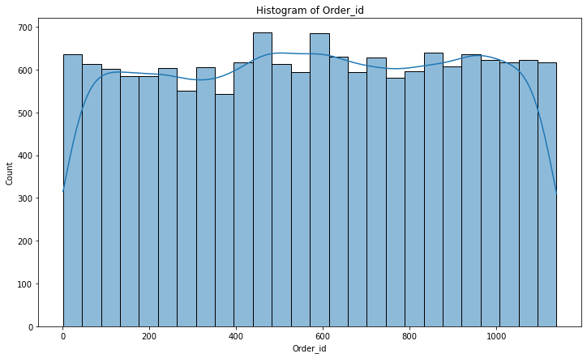
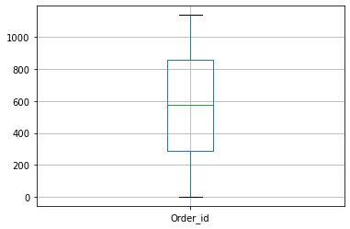
Box –Plot & Histogram Representation
1.Box-Plot
2.Histogram
From the above plot it is clear that there are no outliers and the data is normally distributed. (As the data shown is of Order id.)

Slide 8
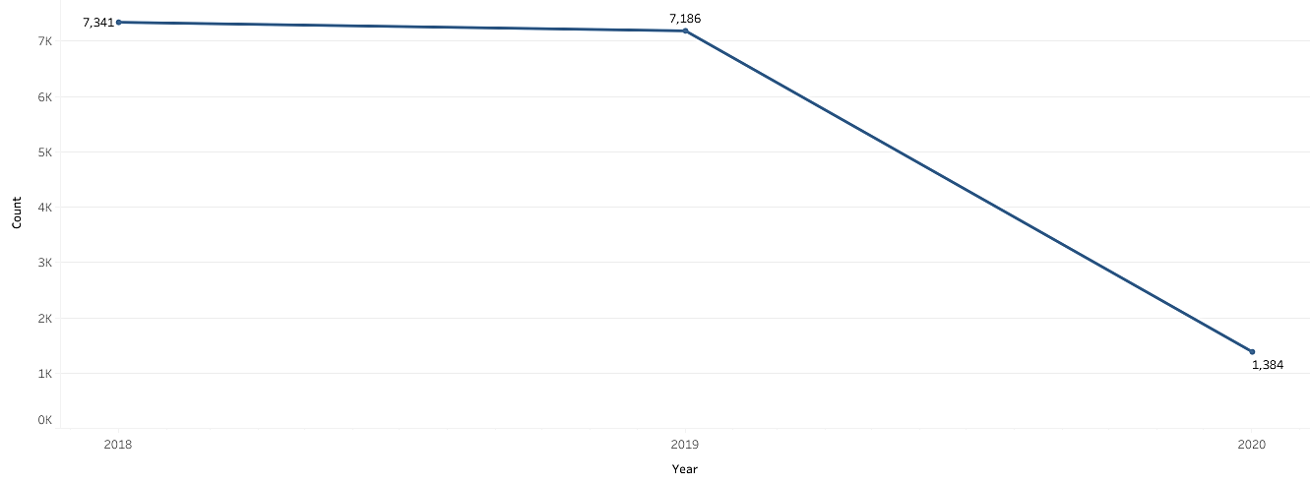
Sales across Years
By looking at the year graph, it is clear that there is a downtrend in the purchasing of goods from the store.
For year 2018 & 2019 the sales remain pretty much same.

Slide 9
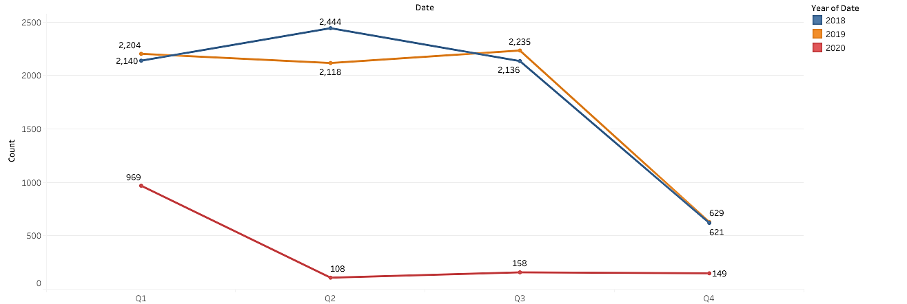
Year Vs Quarterly Sales of Items
Somewhat similar kind of trend we get to see in the quarterly sales graph.Q2 & Q3 being highest in 2018 and 2019 respectively with Q4 generating the lowest sales in both years
But in 2020, there is a decline in sales.

Slide 10
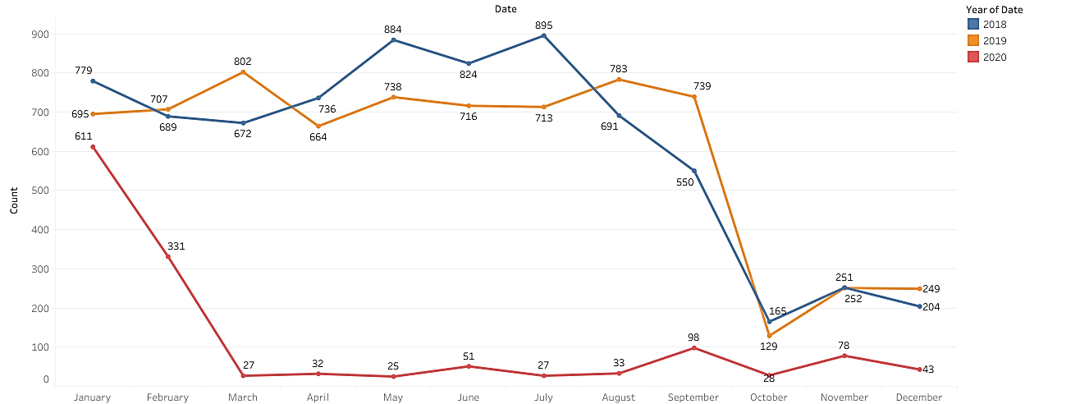
Year vs Monthly Sales of Items
We are not able pick any particular pattern from the monthly graph.
For year 2018, maximum sales has occur in month of July and in 2019 it has happen in August but towards the end there is a downfall in sales.

Slide 11
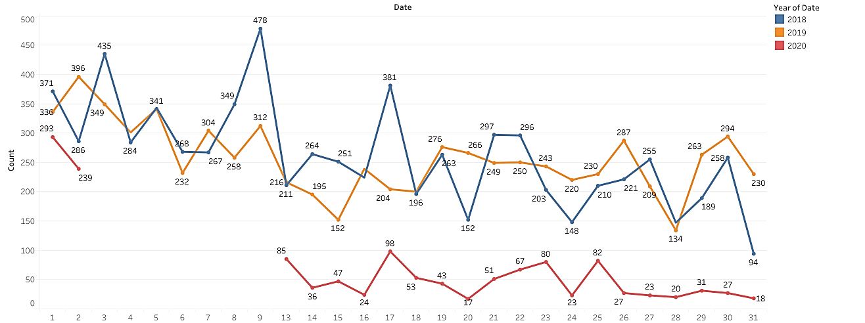
Day-Wise Sales Representation
There is some missing values from date 3 to 9 for year 2020 and there is no data of sales from 10 to 12 of each month.

Slide 12
MBA (Market Basket Analysis):
Market Basket Analysis is a technique to identify the strength of association between pairs of products purchased together and identify patterns of co-occurrence.
Market Basket Analysis creates If-Then scenario rules, for example, if item A is purchased then item B is likely to be purchased. The rules are probabilistic in nature or, we can say they are derived from the frequencies of co-occurrence in the observations. Frequency is the proportion of baskets that contain the items of interest.
The rules can be used in pricing strategies, product placement, and various types of cross-selling strategies.

Slide 13
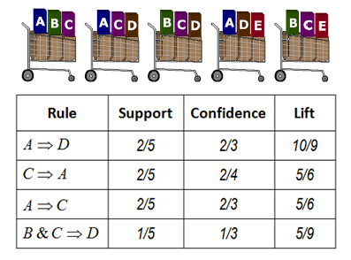
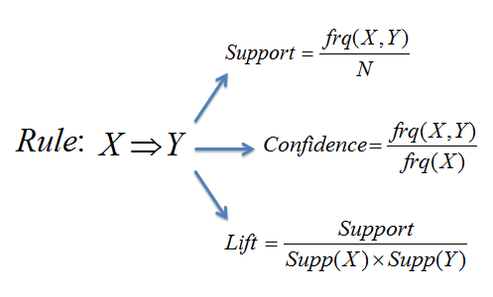
Association Rules
Association rules are "if-then" statements, that help to show the probability of relationships between data items, within large data sets in various types of databases.
In data mining, association rules are useful for analyzing and predicting customer behavior. They play an important part in customer analytics, market basket analysis, product clustering, catalog design and store layout.
Common factors of Association rules: Support, Confidence and Lift
Support: Support refers to how often a given rule appears in the database being mined.
Confidence: Confidence refers to the amount of times a given rule turns out to be true in practice.
Lift: It is the ratio of the confidence of the rule and the expected confidence of the rule.

Slide 14
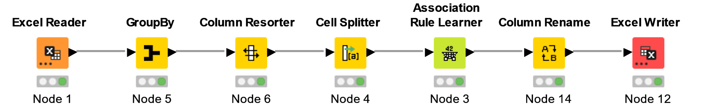
Workflow Diagram of KNIME
Threshold Value for:
Support : 0.05
Confidence: 0.35

Slide 15
Sample of Association of DataSet
Support | Confidence | Lift | Rec_Product | implies | Basket Products
0.099209833 | 0.579487179 | 1.489923019 | dinner rolls | <--- | [spaghetti sauce, poultry]
0.095697981 | 0.545 | 1.446981352 | juice | <--- | [poultry, aluminum foil]
0.090430202 | 0.528205128 | 1.422282839 | pasta | <--- | [dinner rolls, soda]
0.094820018 | 0.553846154 | 1.420790021 | eggs | <--- | [dinner rolls, soda]
0.092186128 | 0.552631579 | 1.414488468 | soda | <--- | [eggs, soap]
0.091308165 | 0.525252525 | 1.41433245 | pasta | <--- | [eggs, dinner rolls]
0.095697981 | 0.542288557 | 1.410197869 | aluminum foil | <--- | [poultry, juice]
0.093064091 | 0.540816327 | 1.406369397 | yogurt | <--- | [juice, aluminum foil]
0.094820018 | 0.545454545 | 1.396118488 | soda | <--- | [eggs, dinner rolls]
Threshold Value for:
Support : 0.09
Confidence: 0.45

Slide 16
Association Identified
Support | Confidence | Lift | Rec_Product | implies | Basket Products
0.050921861 | 0.674418605 | 1.726208518 | cheeses | <--- | [bagels, cereals, sandwich bags]
0.051799824 | 0.686046512 | 1.627931202 | poultry | <--- | [dinner rolls, spaghetti sauce, ice cream]
From above table it looks like 5% customer who bought bagels, cereals, sandwich bags has also bought cheeses with a confidence of 67% confidence having a lift of 1.72.
Again 5% customer with a confidence of 68% have dinner rolls, spaghetti sauce, ice cream have also bought poultry with a lift of 1.62

Slide 17
Association Identified
Support | Confidence | Lift | Rec_Product | implies | Basket Products
0.052677788 | 0.361445783 | 0.906799002 | ice cream | <--- | [laundry detergent, coffee/tea]
0.050921861 | 0.355828221 | 0.910760323 | cheeses | <--- | [tortillas, juice]
0.057945566 | 0.360655738 | 0.91489284 | waffles | <--- | [milk, beef]
0.054433714 | 0.358381503 | 0.917295577 | soda | <--- | [hand soap, mixes]
0.052677788 | 0.357142857 | 0.918252177 | dinner rolls | <--- | [fruits, ketchup]
0.057067603 | 0.359116022 | 0.919175616 | cheeses | <--- | [eggs, tortillas]
0.053555751 | 0.356725146 | 0.919253261 | dishwashing liquid/detergent | <--- | [spaghetti sauce, sandwich loaves]
0.054433714 | 0.364705882 | 0.921064302 | cereals | <--- | [all- purpose, soda]
0.050043898 | 0.367741935 | 0.922594856 | ice cream | <--- | [yogurt, hand soap]
0.054433714 | 0.360465116 | 0.922628691 | soda | <--- | [all- purpose, cereals]
From above table it looks like customers are unlikely to buy ice cream with laundry detergents, coffee/tea and with yogurt, hand soap as its lift is very low of 0.90 and 0.92 respectively.
Similarly for cheeses is unlikely to be bought with tortillas, juice and eggs, tortillas.
And it looks like most customer doesn’t like to eat waffles with milk and beef as it has very low confidence of 36%.

Slide 18
Recommendations & Offers
It is very difficult to find any kind of buying pattern of customers.
And there is no seasonality to the buying patterns of customers.
We have found around 24000 association rules regarding the given datasets.
We can combine a high selling product with a low selling products so that the stock get renewed from time to time.
It will also help in increasing the sales of low performing items which in turn results in increase of sales overall.
We can offer combos on ice cream and yogurt as most customers have bought both and buying of one product can lead to buying of other products like yogurt → milk, fruits and juice and ice cream → paper towels, fruits and pasta.
10-15% discount on poultry and Beef if bought together
5- 10% discount on ice cream and milk if bought together.
A combo of Sandwich loaves and aluminum foil
Or maybe a combo of Sandwich loaves and poultry
Combo of dishwashing liquids and hand soap
May be a discount on eggs carton and on lunch meat could introduced by store.

